Slide 1
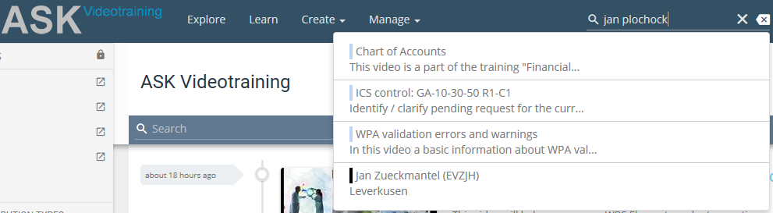
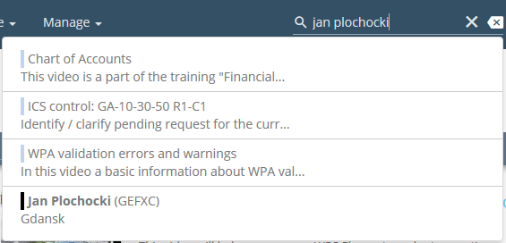
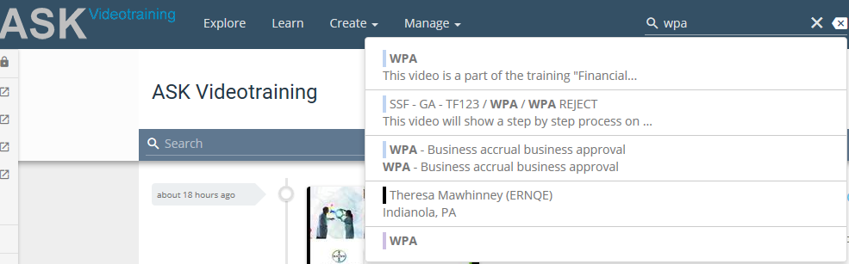
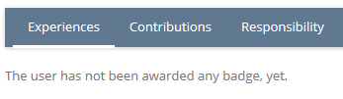

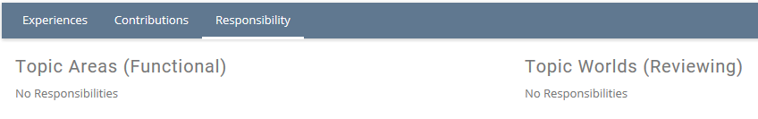
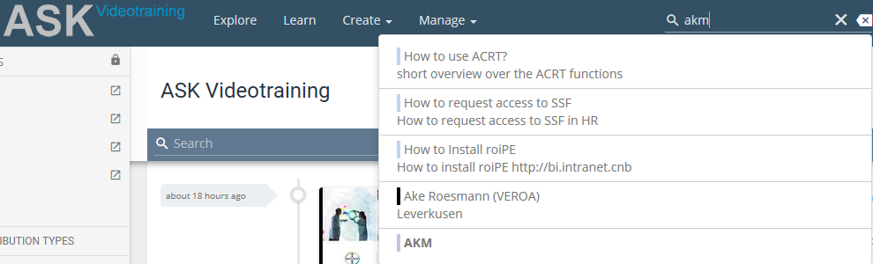

ASK Videotraining
Text search accuracy
Searched phrase differs only with one last letter „i” at the end
2.
User information – nothing related to WPA:
3.
First four results not related in any way to „AKM” phrase (tool used in GA department).

Slide 2
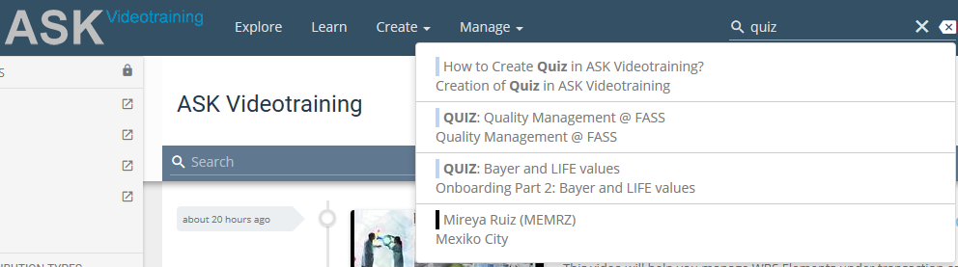
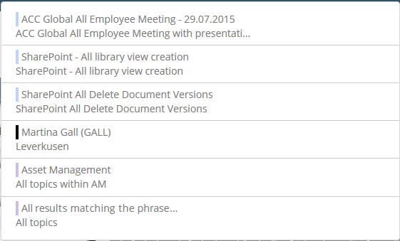
ASK Videotraining
Text search accuracy
User information – nothing related to quiz:
5.
NOTE: It might be worth considering adding additional line within results called e.g. „All results matching the phrase…” where you colud go to the list of all results to have a broader range to choose from (not 4 or 5 results).
E.g. like this

